Slide 1
Sternfeuerung 1.0

Slide 2


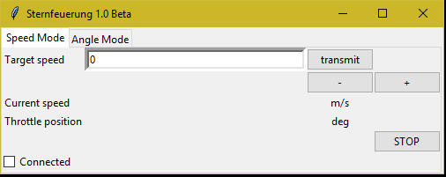
How does it work? Part 1
#include: Tkinter
→ for graphic user interface (gui)
#include: PyLSL
→ Lab streaming layer
transfer data in a LAN
Fastest possible latency
User data

Slide 3
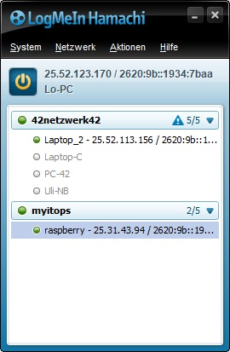
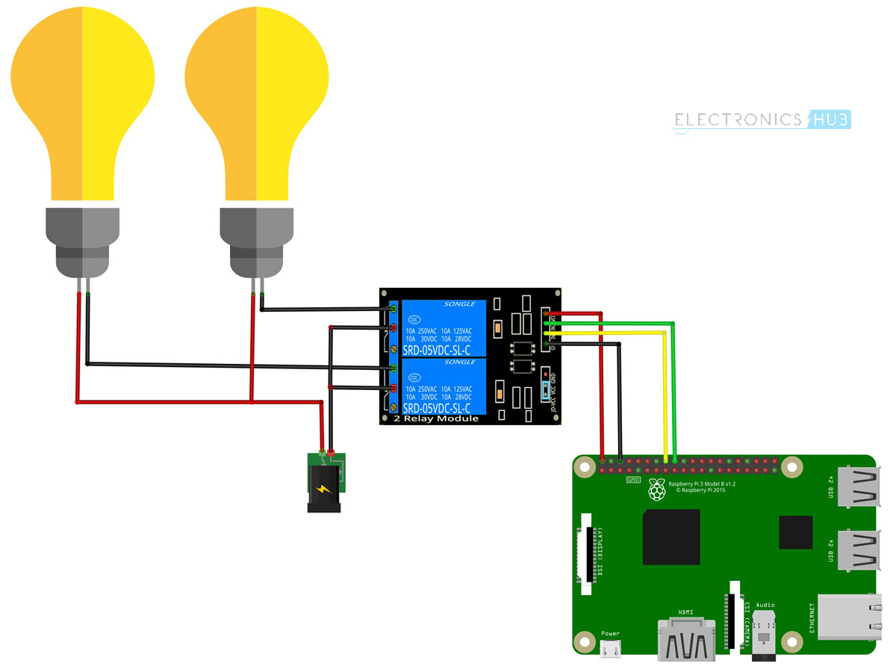
How does it work? Part 2
Hamachi Server simulates a local area network (LAN)

Slide 4
How does it work? Part 3
#include: PiGPIO
→ Stable servo motor signal
→ CPU load independent
Actual Vehicle Speed
Actuator

Slide 5
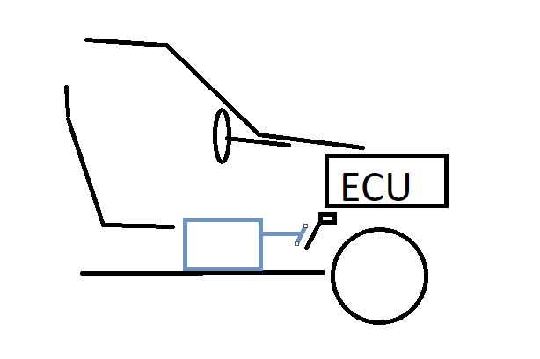
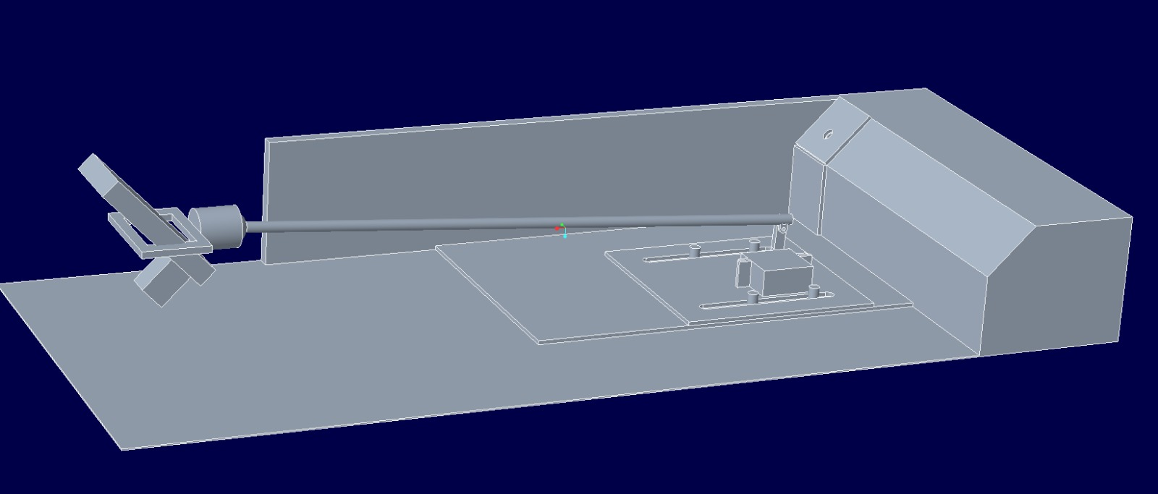
How does it work? Part 4
Actual Vehicle Speed
Throttle position
Actuator

Slide 7
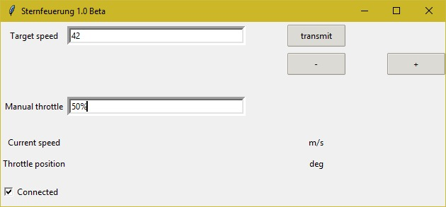
How does it work? All in one
User data

